Slide 1
Excretion
Chapter 13

Slide 2
Excretion
Excretion is the process of removing from organisms of the waste products of metabolism, toxic materials and substances in excess of requirements.
Excretory wastes
Nitrogenous wastes such as urea and uric acid; Spent hormones;
Excess salts;
Excess water;
Drugs;
Note: excretion is different from egestion (removal of faeces).

Slide 3
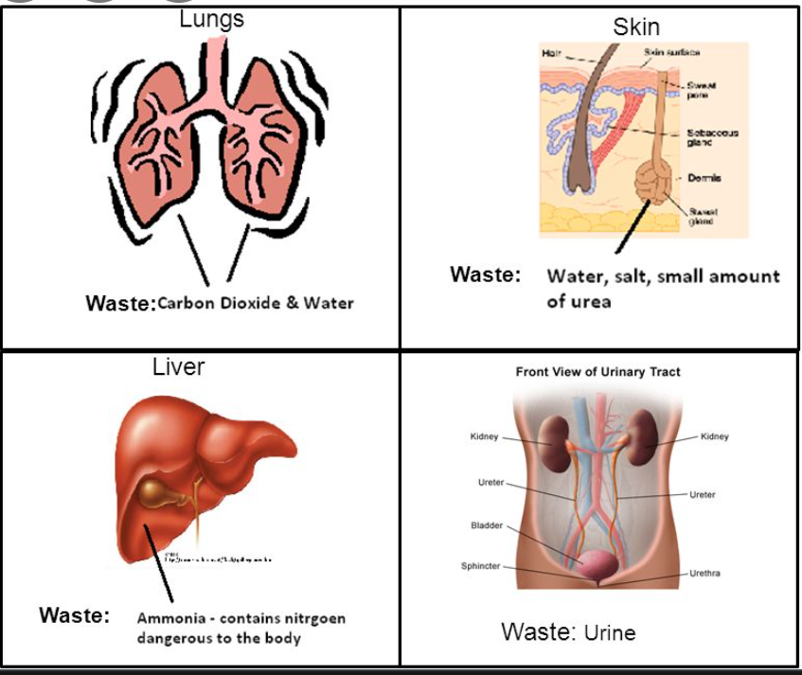
Excretory orgns
Excretory Organs
Lungs: remove carbon dioxide and water vapour (incidental loss).
Kidneys: remove urea, uric acid, excess water, salts, hormones and drugs.
Liver: excrete bile pigments (bilirubin) with bile into the small intestine.
Note: The skin secretes sweat in the form of perspiration (incidental loss).

Slide 4
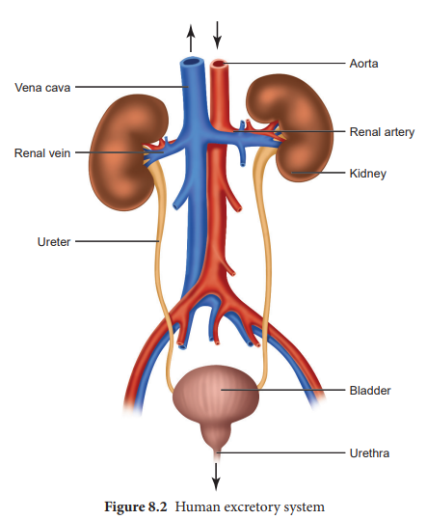
Human Excretory System

Slide 5
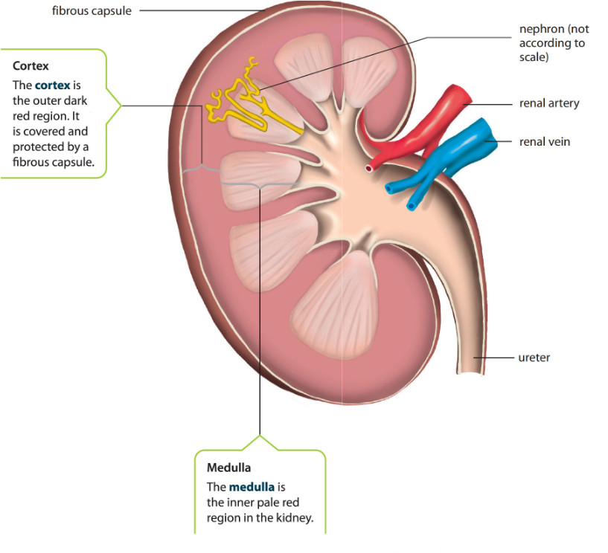
Kidney
Kidneys: bean shaped, with red brown colour, they are located at the back of the abdominal cavity.
A longitudinal section through a kidney shows the following regions:
Cortex: outer region;
Medulla: inner region;
Renal Pelvis: a funnel shaped structure in the kidney.
Note: the ureter joins the kidney at the renal pelvis
Connected to each kidney
Renal artery: branches off from the aorta and brings oxygenated blood and is loaded with urea, water, and salts;
Renal vein: takes deoxygenated blood away from the kidneys to the inferior vena cava and contains less water and salts, and no or less urea.

Slide 6
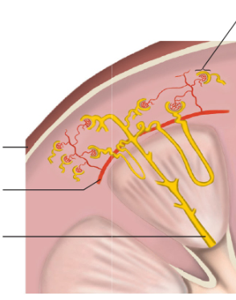
What is a nephron?
A nephron is the basic unit of the kidney.
Each nephron consists of a single glomerulus with its renal capsule, renal tubule and blood capillaries.
Renal capsule is a cup shaped structure that encloses a bed of capillaries called glomerulus.
Renal tubule (with loop of Henle to conserve water): is a long tube with permeable walls and it opens into a collecting duct.

Slide 7
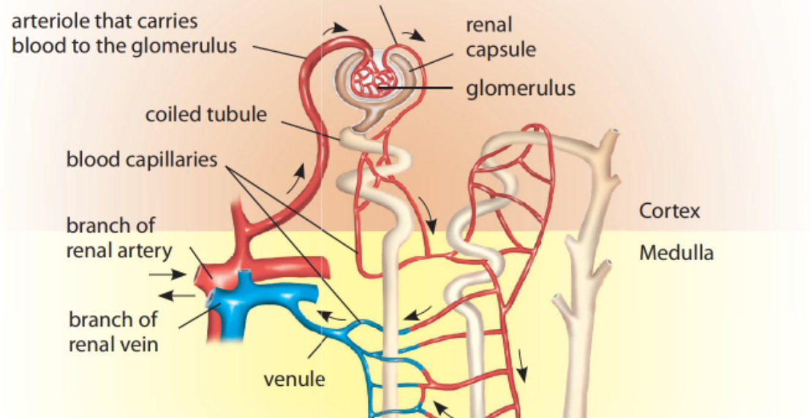

Slide 8
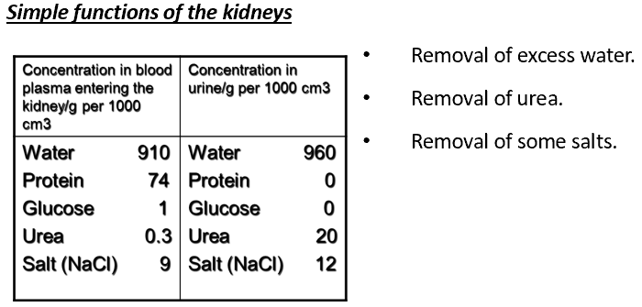
Simple functions of the kidney

Slide 9
How Urine is Formed?

Slide 10
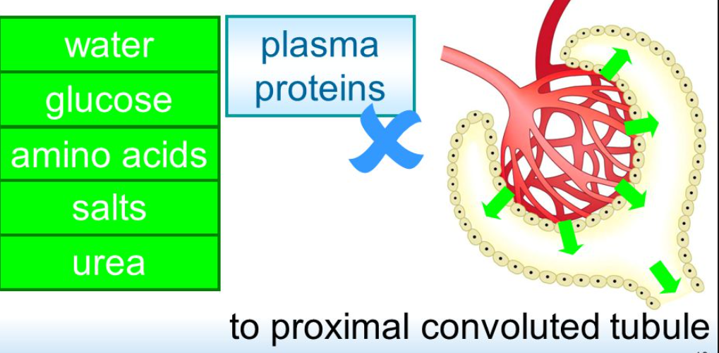
A. Ultrafiltration
Ultra-filtration: is the process through which small molecules from blood (salts, glucose, water, urea….) are forced out of the glomerulus into renal capsule.
Proteins and blood cells which are too large to pass through the walls remain in the capillaries.

Slide 11
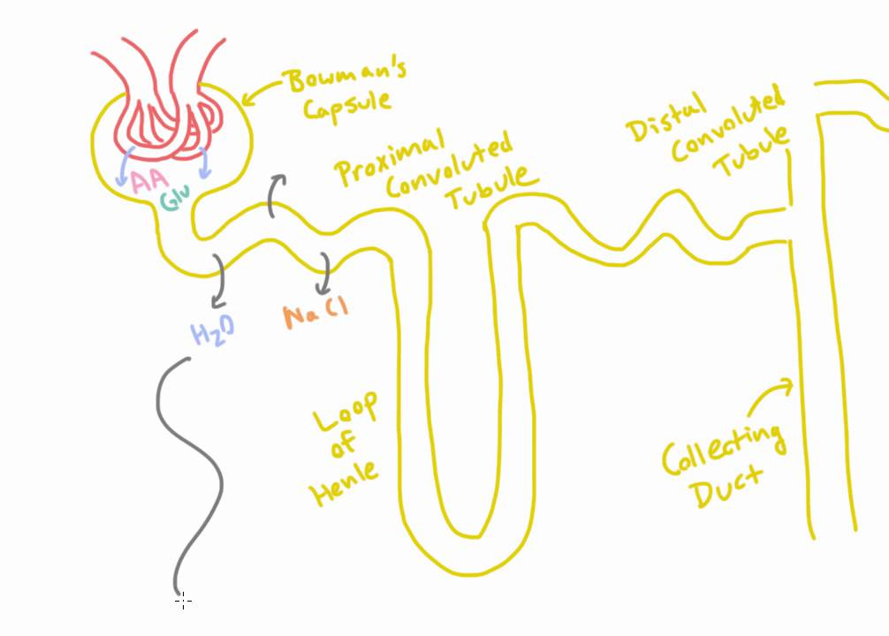
B- Selective Reabsorption
It is the process through which substances (all glucose, some water and essential salts) flowing through the renal tubule return to the blood by passing through the renal tubule walls and entering the surrounding capillaries.
All glucose is reabsorbed by active transport
Some ions are reabsorbed by active transport
Most of the water is reabsorbed by osmosis

Slide 12
Formation of the urine
Salts not needed by the body, water with urea and uric acid pass down the renal tubule into the collecting duct and gather in the renal pelvis, here the fluid is called urine.
Path way of urine
Urine in renal pelvis ureter urinary bladder urethra outside the body
Urinary bladder
It is a muscular sac which can expand to hold 400cm3 of urine.
Urination is controlled by a band of circular muscle called sphincter. When sphincter muscle relaxes, bladder expels urine through the urethra.

Slide 13
How is Glomerulus suited to filtration?
Presence of | Importance
There are numerous glomeruli in the kidney and blood capillaries are highly coiled | Provide large surface area of filtration
The walls of the capillaries are only one cell thick and contain tiny pores(fenestrations) | Allow passage of small substances only
Blood capillaries are covered by partially permeable thin basement membrane | Allows very small soluble molecules or ions to pass while impermeable to RBCS, platelets and proteins

